Slide 1
ST 411/511: Methods of Data Analysis Winter 2023
Lecture 24
Monday, March 13, 2023

Slide 2
Today’s Outline:
Linear Regression assumptions for inference
Log transform:
indications and interpretations
Lack of fit F-test (when replicate observations at each X)
Extrapolation
R-squared

Slide 3
Linear Regression Inference Assumptions
Assumptions for inference:
The linear model is correct: the mean of Y actually is a linear function of X, that is,
μ(Y| X) = β₀ + β₁X,
The pairs of observations (X_{i}, Y_{i}) are independent of each other.
The variance of each Y_{i} around its mean μ(Y_{i}| X_{i}) = β₀ + β₁X_{i} is the same value σ² (i.e. constant variance, homoskedasticity).
The distribution of Y_{i} around its mean μ(Y_{i}| X_{i}) = β₀ + β₁X_{i} is Normal (i.e. the subpopulation (or group) corresponding to the value of X_{i} is Normal with mean β₀ + β₁X_{i} and variance σ²)
- OR -
We have a reasonably large sample size n.

Slide 4
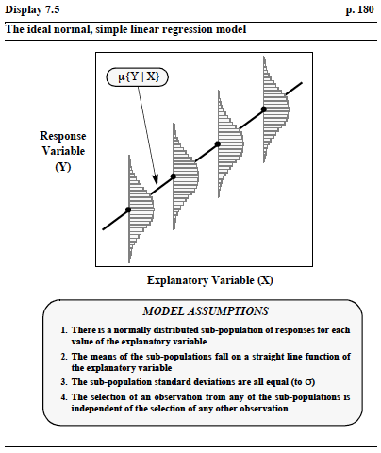
Linear Regression Inference Assumptions

Slide 5
Robustness to Violations of Assumptions
Linearity
Consequences of violation of linearity depend on how non-linear the relationship is
Also depends on the goal of analysis
Textbook perspective: goal is to accurately model the mean of Y at each value of X
My perspective: goal is to answer questions about a general trend in the mean values of Y as X changes
In this case, violation of linearity is a less severe problem.

Slide 6
Robustness to Violations of Assumptions
Constant Variance
Not robust to violations of constant variance
…but there are alternatives if you are only interested in inference for the regression parameters
‘Robust standard error’ estimates, also called ‘sandwich estimator’
These don’t help if your goal is prediction at a given X value

Slide 7
Robustness to Violations of Assumptions
Independence of observations
Not robust to violations of independence!
Normality of subpopulations
Inference for the regression parameters and the subpopulation means are very robust to departures from normality (CLT!)
To the extent that I do not generally recommend a normal probability plot to explore this assumption
However, prediction interval coverage will be less robust to violations of normality

Slide 8
Plots to Assess Regression Assumptions
Predictor vs. Response
Assess general trend, linearity
Assess constant variance
Look for outliers
Residual vs. Fitted value (or Residual vs. Predictor)
Assess linearity
Assess constant variance
Look for outliers
Normal Probability plots (quantile-quantile plots or ‘qqplots’)
Assess normality of subpopulations

Slide 9
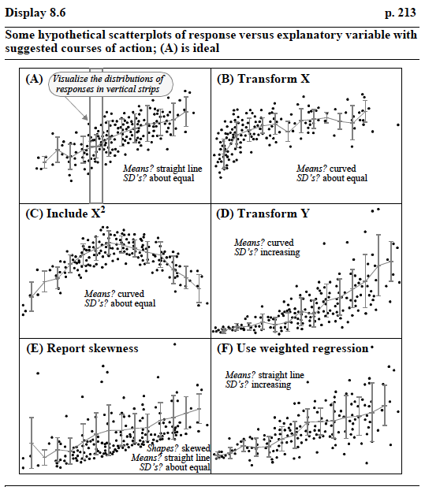
Plots to Assess Assumptions

Slide 10
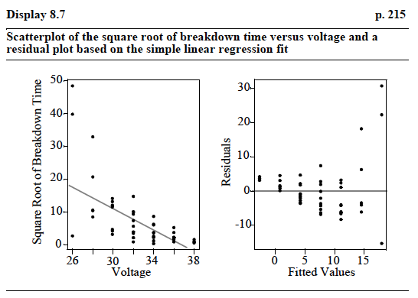
Plots to Assess Assumptions

Slide 11
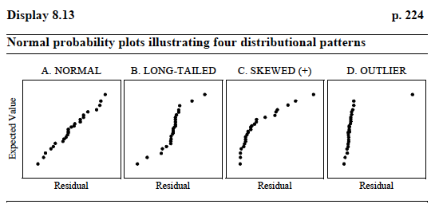
Plots to Assess Assumptions

Slide 12
Simple Linear Regression Assumptions and Transformations

Slide 13
Simple Linear Regression Assumptions and Transformations
Linear Trend?

Slide 14
Simple Linear Regression Assumptions and Transformations
YES
NO
Linear Trend?
NO
NO

Slide 15
Simple Linear Regression Assumptions and Transformations
Constant Variance?

Slide 16
Simple Linear Regression Assumptions and Transformations
YES
YES
Constant Variance?
NO
NO

Slide 17
Simple Linear Regression Assumptions and Transformations
Remedy?
Log Transform may improve these issues

Slide 18
Simple Linear Regression Assumptions and Transformations
Remedy?
Log Transform may improve these issues
Log Transform Predictor (X) when:
(1) The curve is non-linear

Slide 19
Simple Linear Regression Assumptions and Transformations
Log Transform Response (Y) when:
The curve is non-linear
The spread increases as μ(Y| X) increases
Remedy?
Log Transform may improve these issues

Slide 20
Simple Linear Regression Assumptions and Transformations

Slide 21
Simple Linear Regression Assumptions and Transformations
How to decide whether to transform X, Y, or both?
Textbook: Consider plots with all combinations, and choose the one that looks most linear and has most constant spread.

Slide 22
Simple Linear Regression Assumptions and Transformations
How to decide whether to transform X, Y, or both?
Textbook: Consider plots with all combinations, and choose the one that looks most linear and has most constant spread

Slide 23
Simple Linear Regression: Interpretation after Log Transform
Log Transform Y:
μ(log(Y)| X) = β₀ + β₁X
exp(μ(log(Y)| X)) = exp(β₀ + β₁X)
Geometric Mean (Y | X) = exp(β₀)exp(β₁X)
The mean of the log-transformed variable, μ(log(Y)), is equal to the log of the geometric mean of the original variable.
We can therefore interpret this model as ‘a 1-unit increase in X is associated with a multiplicative increase of exp(β₁) in the Geometric mean of Y’.

Slide 24
Simple Linear Regression: Interpretation after Log Transform
Log Transform Y:
μ(log(Y)| X) = β₀ + β₁X
exp(μ(log(Y)| X)) = exp(β₀ + β₁X)
Geometric Mean (Y | X) = exp(β₀)exp(β₁X)
Textbook interpretation: IF the mean of log(Y | X) is equal to the median of log(Y | X), we can interpret this as ‘a 1-unit increase in X is associated with a multiplicative increase of exp(β₁) in the median of Y’.

Slide 25
Simple Linear Regression: Interpretation after Log Transform
Log Transform X:
μ(Y| X) = β₀ + β₁log(X)
We can interpret this model as ‘a 1-unit increase in log(X) is associated with an increase of β₁ in the mean of Y’.
Note that a 1-unit increase in log(X) is equivalent to a multiplicative increase of exp(1) = e in X.
Therefore, equivalently, ‘a doubling of X is associated with an increase of β₁log(2) in the mean of Y.’

Slide 26
Simple Linear Regression: Interpretation after Log Transform
Log Transform X and Y:
μ(log(Y)| X) = β₀ + β₁log(X)
We can interpret this model as ‘a 1-unit increase in log(X) is associated with a multiplicative increase of exp(β₁) in the Geometric mean of Y’.

Slide 27
Simple Linear Regression: Interpretation after Log Transform
Note that in all cases, the interpretation of the model (i.e., the question answered) changes.
And you have added some subjectivity to your analysis by looking at the data to decide on the analysis method.
p-values are therefore less valid
Confirmatory analysis on a new data-set should be performed if you would like to get more valid p-values.

Slide 28
Assessment of Linear Fit using ANOVA
When you have multiple observations at some or all values of X in your dataset, you can compare the simple linear regression model
μ(Y| X) = β₀ + β₁X
to the separate means model
μ(Y| X) = μ_{X}
by performing an Extra-sum-of-squares F-test called a ‘Lack of Fit Test’

Slide 29
Assessment of Linear Fit using ANOVA
When you have multiple observations at some or all values of X in your dataset, you can compare the simple linear regression model
μ(Y| X) = β₀ + β₁X
to the separate means model
μ(Y| X) = μ_{X}
by performing an Extra-sum-of-squares F-test called a ‘Lack of Fit Test’
Less flexible
More flexible

Slide 30
Assessment of Linear Fit using ANOVA
Example: Insulating Fluid breakdown time under different voltages
Under uniform conditions, batches of insulating fluid were exposed to constant voltages until the insulating properties of the fluid were destroyed.
Seven different voltages were explored: 26, 28, 30, 32, 35, 36, 38 kV

Slide 31
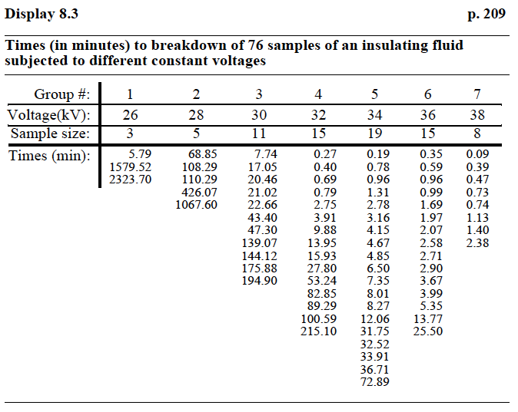
Assessment of Linear Fit using ANOVA

Slide 32
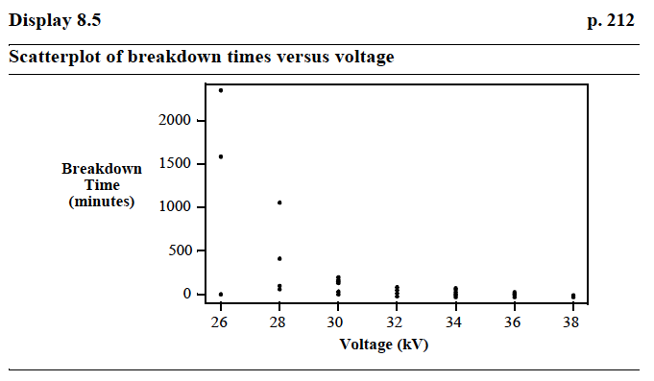
Assessment of Linear Fit using ANOVA

Slide 33
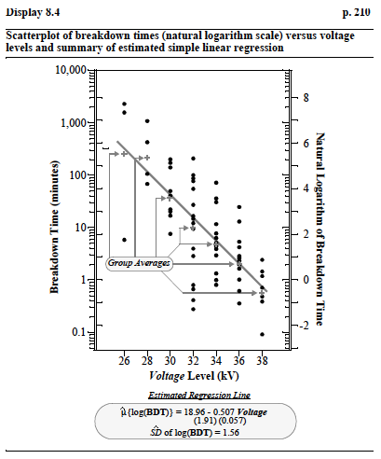
Assessment of Linear Fit using ANOVA

Slide 34
Assessment of Linear Fit using ANOVA
The lack-of-fit (i.e., lack-of-linear-fit) F-statistic is
SSR_{LR} = Sum of squared residuals for the linear regression model
SSR_{SM} = Sum of squared residuals for the separate means model
df_{LR} = (n – 2) = Degrees of freedom for the linear regression model
df_{SM} = (n – M) = Degrees of freedom for the separate means model
Hypothesis tested:
H₀: Linear Model is Adequate
vs.
H_{A}: Linear Model is NOT Adequate
(i.e. we need the greater flexibility of the separate means model)

Slide 35
Assessment of Linear Fit using ANOVA
Compare the lack-of-fit F statistic to an F distribution with
(df_{LR} – df_{SM}) numerator degrees of freedom
df_{SM} denominator degrees of freedom
p-value:
1 – pf(F, (df_{LR} – df_{SM}), df_{SM})
Reject H₀: Linear model is adequate for large values of F (i.e. when the sum of squared residuals for the linear model are much larger than the sum of squared residuals for the separate means model)
Reject H₀ if F > qf(1 – α, (df_{LR} – df_{SM}), df_{SM})

Slide 36
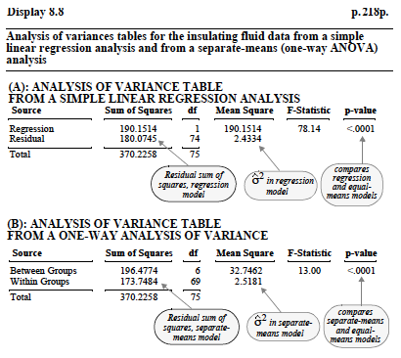
Assessment of Linear Fit using ANOVA

Slide 37
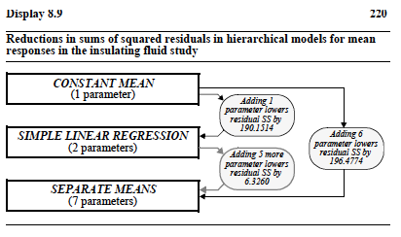
Assessment of Linear Fit using ANOVA

Slide 38
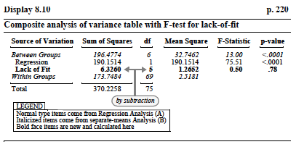
Assessment of Linear Fit using ANOVA
If the simple linear regression model fits, it is preferred: Occam’s Razor
(easier interpretation, interpolation, more degrees of freedom for error estimation)

Slide 39
Final Notes on Simple Linear Regression
Interpolation vs. Extrapolation:
It is risky and unsound to extrapolate: that is, to extend simple linear regression inference beyond the range of X values observed.
For example, if we model height (Y) as a function of age (X) for girls aged 2 – 13, we find
μ(Y| X) = 30 + 2.66*X
but it would be incorrect to conclude that someone who is X = 40 yrs should be 30 + 2.66*40 = 136.4 inches tall (i.e. 11 feet 5 inches)

